Slide 1
VDM recursion in Isabelle/HOL
Leo Freitas and Peter Gorm Larsen
21st Overture Workshop, Lubeck March 2023
Notes:
Introduce the VDM toolkit project and translation first

Slide 2
Model based design with VDM
Modelling aspects
Abstract data types with invariant and ordering,
Function definitions with specification (pre/post/measures),
State rich definitions with statements, variable frames and operations.
Symbolic execution
Interpretation of mathematical properties of systems (e.g. possibly with OO and RT features)
Limited type scope (e.g. mostly without explicit type bindings; no “x : nat”)
Testing:
Combinatorial traces
Code coverage
Verification:
PO generation
Quick check (PO disproof) within given domains
Various proof support attempts since Jones’ Mural theorem prover halted
No symbolic counter example (no model-based / unbounded counter examples)
Notes:
Remind (very briefly) the spectrum of VDM modelling

Slide 3
VDM proof support history since Mural (1991)
Maharaj & Bicarregui (shallow) embedding of VDM in PVS (1998)
https://www.researchgate.net/publication/2510095_On_the_Verification_of_VDM_Specification_and_Refinement_with_PVS
Karabotsos (deep) embedding of VDM (LPF) in Isabelle/HOL (2005)
https://spectrum.library.concordia.ca/id/eprint/8505/1/MR10289.pdf
Freitas & Woodcock soundness argument/result for VDM proofs in other logics (2008)
Unifying Theories of Undefinedness [https://doi.org/10.3233/978-1-58603-976-9-311]
Linking Z and VDM: (Z semi-classical) logic prover for VDM (LPF) theorems [https://ieeexplore.ieee.org/document/4492887]
Vermolen, Hooman & Larsen (shallow) embedding of VDM in HOL (2010)
Hand-crafted proof tactics [https://dl.acm.org/doi/10.1145/1774088.1774608]
Freitas & Whiteside (shallow) embedding of VDM in Isabelle/HOL (2014)
VDM theorems proved in Z and Isabelle/HOL [https://link.springer.com/chapter/10.1007/978-3-319-06410-9_20]
Freitas automated (shallow) embedding of VDM in Isabelle/HOL with proof crafting support (2021)
VDM toolkit project [https://github.com/leouk/VDM_Toolkit]
Notes:
Manual (shallow) embedding in PVS which attempts to stick to LPF (i.e. missed the formal argument a VDM theorem can be proved in other logics).
Motivated in experimenting with VDM mechanisation
Deep embedding of VDM-LPF in Isabelle. Experimentation with LPF in HOL.
Theoretical result of network of logical semantic systems with galois connections between them showing how to prove theorems between them. Concrete examples with linking Z and VDM logics
Hand crafted proof tactics with shallow embedding; didn’t get far in the language support
Shallow embedding of VDM taking 3)’s result into account
Generalisation of 5) which was the beginning of current translation strategy

Slide 4
VDM to Isabelle translation strategy 101
Translation strategy started (2010) as part of the AI4FM project (2010-2014)
Attempt to identify proof strategy reuse across provers (Isabelle, ZEves) and models (VDM and Z)
Technical report on a translation strategy for most of VDM as shallow embedding
Undergraduate course on translating VDM to Isabelle (manually) (2012-2022)
Considering new targets: Dafny + Lean 4
VDM LPF
Pragmatic approach similar to VDMJ’s: a L-R logic (e.g. subset of LPF) with “possible” typing rules
VDM data types
Sets, sequences, maps and records map almost directly to Isabelle libraries
Numeric types cannot be directly translated given VDM widening-type rules (e.g. “0 - x” becomes int for x:nat)
Set and sequence comprehensions are easy; map comprehension is fiendish
VDM functions
Direct translation as Isabelle definitions for non-recursive functions
Recursive functions support quite limited at first (e.g. only for VDM sequences)
Notes:
Isabelle choice was circumstantial (i.e. Edinbrough group prefered it; We also tried PVS and ACL2)
Considering now other targets like Dafny and/or Lean
PVS might be better suited - VDM ANTLR is enabling that direction
LPF simplification (Z/Eves link then VDMJ itself way of L-R)
Translation in general requires intimate knowledge of both source and target language
Translation for proof purposes require further knowledge about the target prover’s behaviours for most common situations

Slide 5
VDM Toolkit Project https://github.com/leouk/VDM_Toolkit
Initiative to coalesce various VDM-related developments (e.g. libraries, experiments, etc.) since 2010
VDM to Isabelle translator (vdm2isa plugin)
VDMToolkit : Isabelle proof engineering and support for VDM translation and proof automation
exu : VDM style checker and specification reordering (see next talk)
vdm2isa : Syntax-driven VDM to Isabelle translator
isapog : VDM PO translator and proof script / strategy predictor
vdm2isa-lsp : VSCode LSP (editor) + DAP (debugger) integration of plugins
VDM ANTLR
VDM syntax formal definition for parsing, printing, translations, etc.
VDM Libraries
CSV, ISQ, Order, Z-Relations, Dense ranges, Logging, Binary and Matrix arithmetic, General support, etc.
VDM Annotations
Specification profiling; user defined theorems; user defined proof attributes, hints and witnesses.
Notes:
Most translation strategy templates are “obvious”; key is VDMToolkit.thy proof support
VDM ANTLR is also meant to be used as new parser + enable grammar oriented tool integration (e.g. KodKod etc).

Slide 6
Isabelle recursion principles
Primitive recursion
Reduction rules per type constructors; not possible to have pattern matching
Total function with automatic proof
Implemented on top of primitive recursion with extended pattern matching and non-constructive types
Proof obligations:
Pattern compatibility (i.e. is the pattern given matchable to input type?);
Pattern completeness (i.e. are patterns given exhaustive?);
Recursion termination (i.e. are recursive calls well-founded?);
Total (partial) function with user defined proof
Copes with any type and extended pattern as well as partial (non-terminating) functions
Partial functions require abstract domain predicates assumptions (psimps-rules) everywhere!
Pattern compatibility and completeness proofs are mandatory and with reasonable automation support
Termination proofs rely on knowledge of the “Size Change Termination” (SCT) principle(s)!

Slide 7
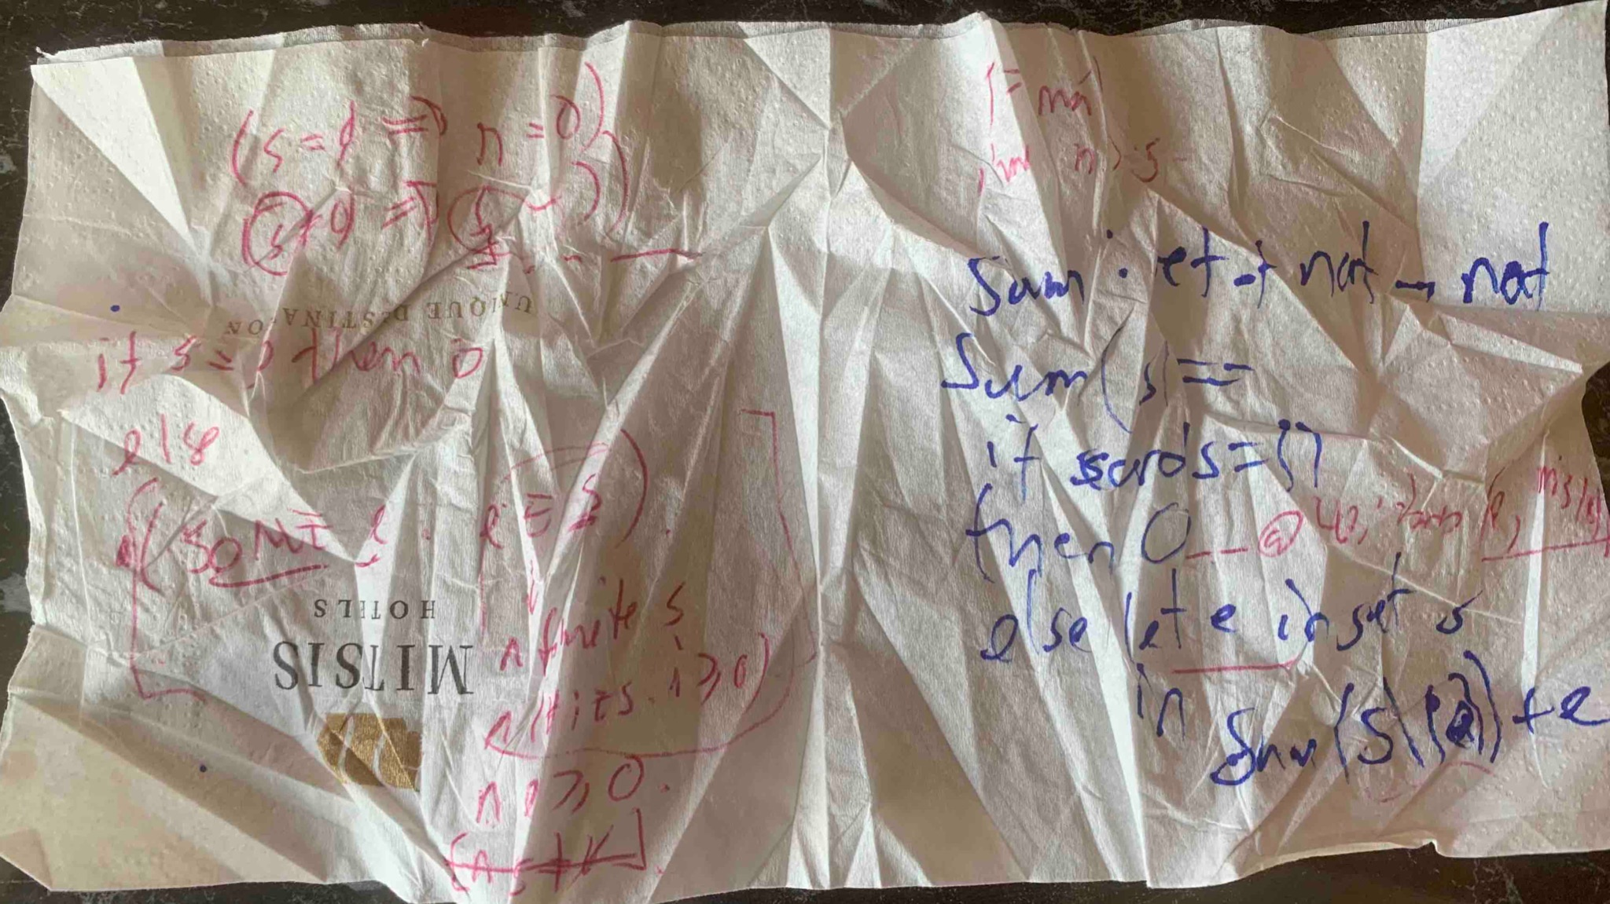
Extending translation of VDM recursion to Isabelle
Translation of recursive functions restricted over VDM sequence parameters only
Recursive functions over nat parameters are (surprisingly) non-trivial!
Users requested support for sets, maps, and of course, nat!
AKA: PGL’s Napkin @ ISoLA22 :-)

Slide 8
VDM-recursion Isabelle-translation caveats
Isabelle (ℕ, ℤ, ℚ, ℝ) types are defined constructively through different embeddings
ℕ: defined inductively over two constructors (e.g. zero and suc n)
ℤ: defined algebraically as a quotient type between two ℕ (e.g. positive and negative parts)
ℚ: defined algebraically as a quotient type between two ℤ (e.g. numerator and denominator parts)
ℝ: defined algebraically as a “vanishing” Cauchy sequence quotient type
VDM type widening rules forces the use of maximal type for translation
In VDM, for a x:nat, “0-x” becomes “-x” of type int. In Isabelle this is “0:ℕ”!
Translation encode VDM nat as VDMNat (ℤ) and ℚ as ℝ
Isabelle recursion must be constructive (i.e. will require various transformations for non ℕ)
VDM recursion over sets and maps are finite; Isabelle sets are infinite and axiomatic
Isabelle requires a constructive well-formed recursive relation; some of which are inferrable
Isabelle will impose well-formed proof obligations for sets and map domain’s finiteness
VDM measures are not expressive enough for certain recursion patterns (e.g. ack, recursive types, etc.)
Some (complex) recursive measures *must* be relational

Slide 9
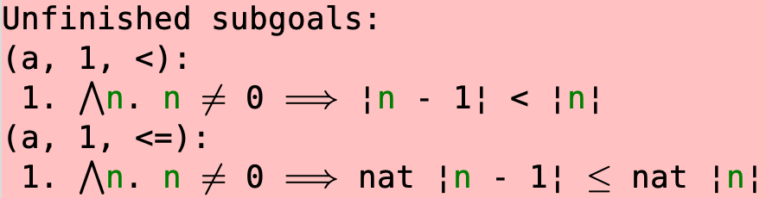
VDM ℕ -factorial example caveats
Recursive VDM factorial
Trivial recursive measure
Isabelle ℕ factorial
Automatically discovered measure
Isabelle VDMNat (ℤ) factorial
Requires user to prove termination

Slide 10
Translation recipe for basic types
Translate (pre/post) specifications
Follows usual VDM translation strategy yet creating definition sets
Translate recursive definition itself
Flag controls whether to try Isabelle discovered proofs (e.g. “fun”) or user defined (e.g. “functions”)
Infers recursive relation from VDM AST
Flag controls whether to generate lemma about well-formedness of inferred recursive relation
Presumes inferred relation is within largest well-formed relation from lower bound (e.g. for ℕ bound is 0)
Sets up pattern consistency, completeness and termination proofs
Pattern proofs are almost always found by sledgehammer (unless wicked patterns or mutually recursive calls)
Termination proof presumes inferred relation is within largest well-formed relation; up to the user otherwise
Harder recursive patterns will require users to define recursive relation as VDM annotations (@IsaMeasure, @Witness)

Slide 11
Isabelle Demo (or see paper theory sources)
https://github.com/leouk/VDM_Toolkit/blob/development/plugins/vdm2isa/pub/recursion/RecursiveVDM.thy
https://github.com/leouk/VDM_Toolkit/blob/development/plugins/vdm2isa/pub/recursion/RecursiveVDM.vdmsl
Recursion for constructively defined basic types (ℕ)
Recursion for non-constructively defined basic types (ℤ)
Recursion for constructively defined structured types (seq) [paper/offline?]
Recursion for non-constructively defined structured types (set and maps) [paper/offline]
Complex recursion patterns (e.g. Ackerman, Permutation, Takeuchi, etc.) [paper/offline]
Simple mutual recursion (e.g. odd and even) [paper]
Complex mutual recursion (e.g. N-Queens, Sudoku solvers) [offline]

Slide 12
Concrete applications
Substantial test-bed for VDM tools themselves
Improvements on all low-level tools (e.g. parser, type checker, POG, cmd-line client, VSCode, etc.)
Inspiration for new tools (e.g., model validators, VDM to UML, VDM quick.check, etc.)
Academic applications
Good number of the VDM-SL example suite translated and proved (with remaining errors fixed!)
Implementation of games of varied complexity useful for teaching + learning about modelling and proof
XO, Suduku, Blackjack, Nim, Dots&Boxes, Victorian Safe, etc.
Eurotransplant organ allocation selection policies
Industrial applications
CANDO Brain pacemaker optrode microchip design and device driver
ScubaTx organ preservation machine embedded control and treatment summaries
Sppok security protocol specification language compiler
UNOS Lung organ allocation policy validation

Slide 13
Discussion
Results
Semi-automated (with proof support) translation recipes/strategies for:
VDM some numeric types (nat, nat1, int)
VDM structured types (sets, sequences, maps)
Automation caters for most common VDM recursive situations
Decreasing nat/int, set (or map domain), sequence
Limitations
Recursive VDM types (e.g. VDM records for say linked lists)
General upper bound for inferred recursive relations works for nat, int and (simple) sets only.
Complexities (e.g. will require user-defined auxiliary lemmas and their proofs)
Recursion over user-defined types
Recursion where recursive relation is outside predefined space
Mutual recursion will necessitate handling Isabelle union types

Slide 14
Discussion
Wish list
completeness of VDM patterns to enable handling FMI models
including Isabelle/LSP back end IDE run in background to attempt proofs automatically
implement complex (and mutual) recursion templates (i.e. POC for now)
VSCode code lenses integration (e.g. akin to jUnit testing)
Influence on how new VDM QuickCheck tool works
????
????

